Slide 1

HUMAN RESOURCES Insights
Prepared By:
Marwan Magdy Mahmoud
Heba Mohamed Abdel Latif Sorrour Hussein Ahmed Mohamed Ahmed Malak hamada Marzouk Shehata Karim Damiana nan Zakaria Zaki
DEPI – Google Data Analytics Initial Presentation
Group ID (CAI2_DAT1_G1)

Slide 2

AGENDA
Introduction
Goal of This Analysis
Key Metrics & Insights
Dashboards
Conclusion

Slide 3
Purpose:
To analyze workforce data and provide insights that enhance HR decision-making.
Scope:
Covers employee demographics, performance, turnover, compensation, and workforce trends.

Slide 4
The Goal of This Analysis:
Enhance Employee Retention
Improve Diversity & Inclusion
Identify key drivers of attrition and implement data-driven retention strategies.
Track and enhance DEI (Diversity, Equity, and Inclusion) efforts.
Optimize Workforce Productivity
Reduce Hiring Costs
Analyze recruitment data to improve hiring efficiency and lower costs.
Measure and improve employee efficiency with performance insights.
HUMAN RESOURCES

Slide 5

Key Metrics & Insights
A. Workforce Demographics
Employee distribution by department, location, tenure, and diversity (age, gender, ethnicity, etc.).
Hiring trends: Number of new hires, internal mobility, and promotions.
B. Employee Performance & Productivity
KPI analysis: Productivity rates, project completion rates, and efficiency scores.
Employee engagement scores based on surveys and feedback.
C. Turnover & Retention
Attrition rate analysis: Voluntary vs. involuntary turnover.
Reasons for attrition: Exit interviews, sentiment analysis, and performance trends.
Retention strategies and their effectiveness.
D. Compensation & Benefits
Salary trends: Comparison across roles, industries, and locations.
Benefit utilization: Employee satisfaction with benefits like healthcare, wellness programs, and training.

Slide 6
Employees Data Model

Slide 7
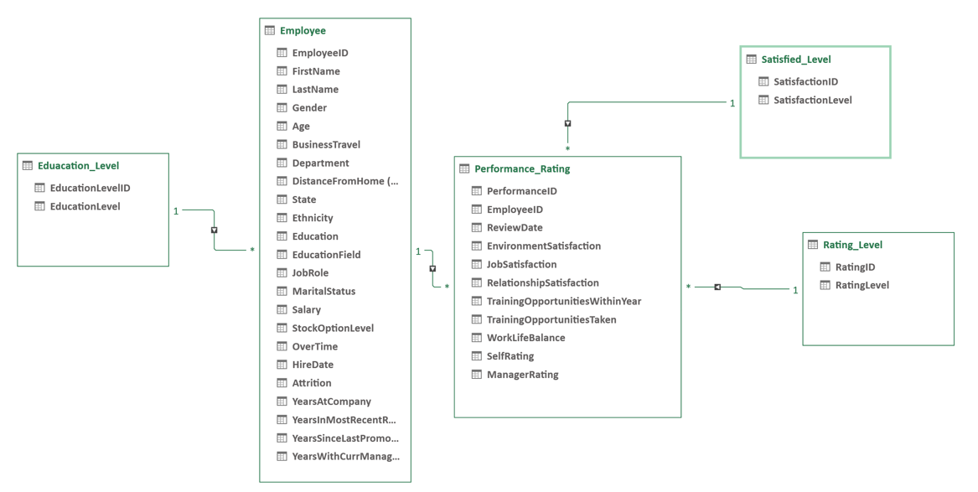
5 main tables
Employee table, with 1470 records.
Performace_Rating table, with 6709 records
Other tables had 5 records each.

Slide 8
Employees overview

Slide 9
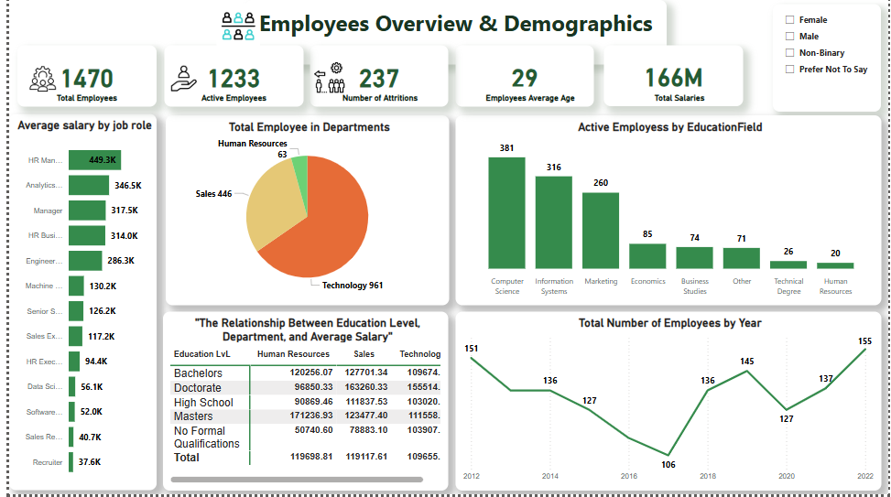

Slide 10
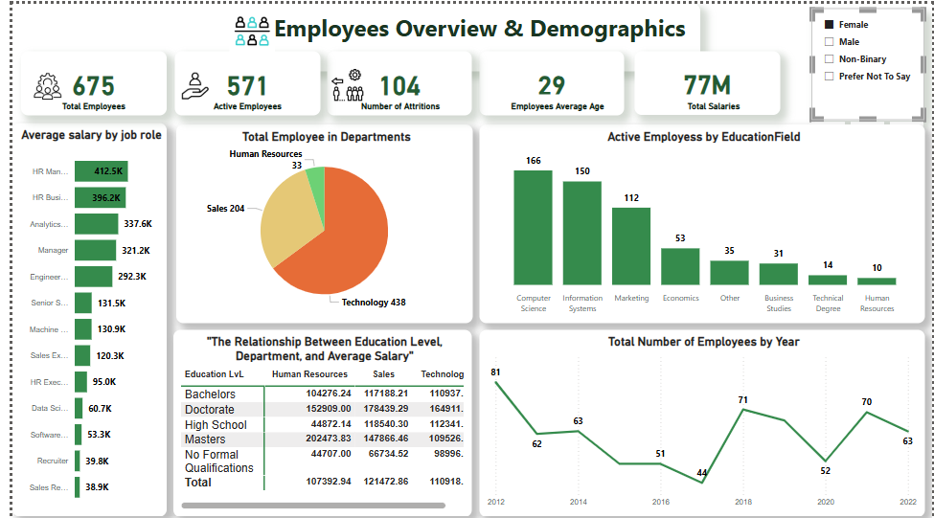
By Female

Slide 11
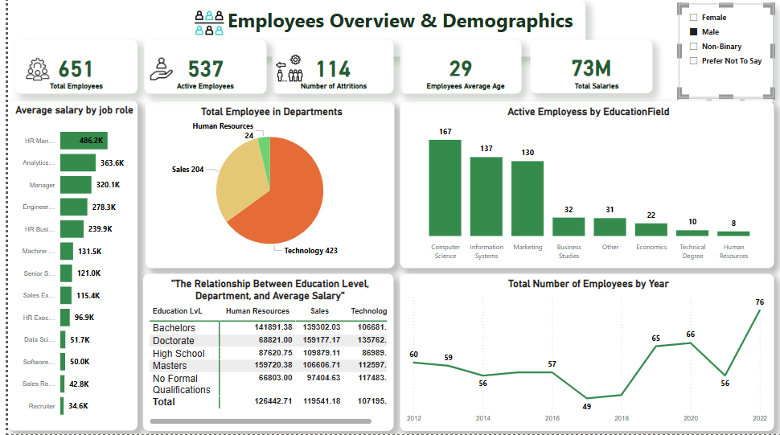
By Male

Slide 12
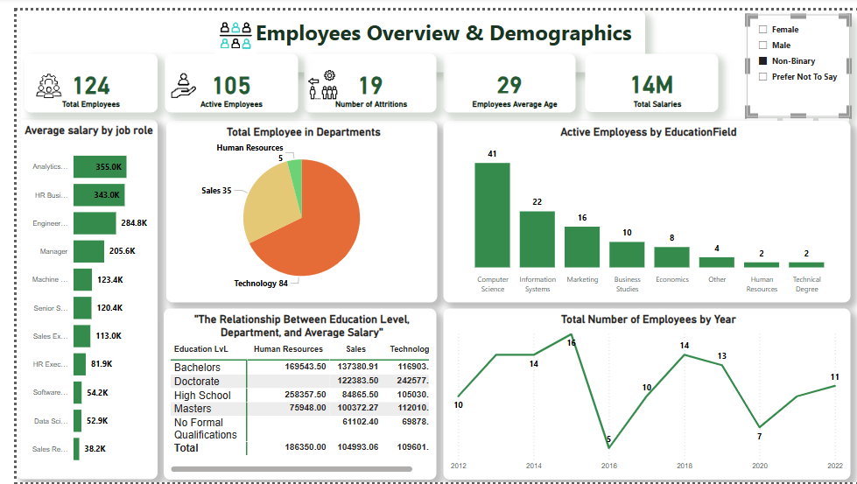
Non-Binary

Slide 13
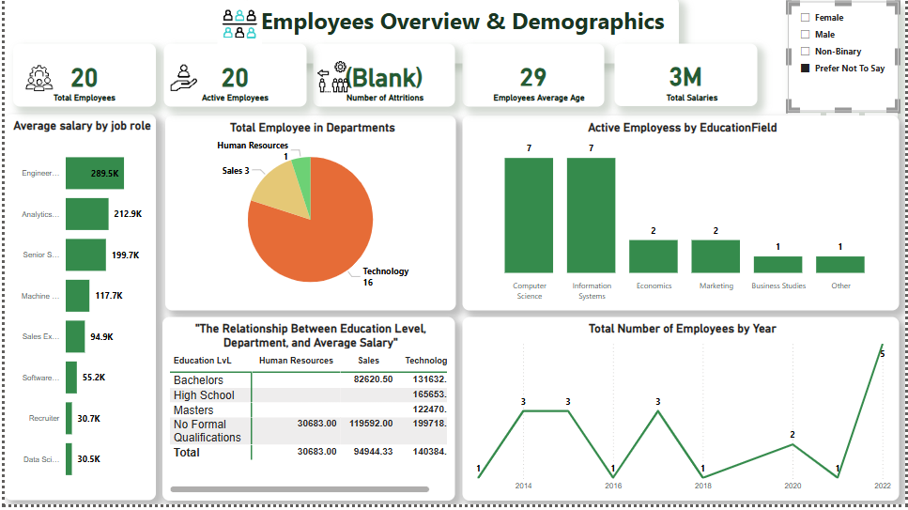
Prefer not to say

Slide 14
Attrition by Department

Slide 15
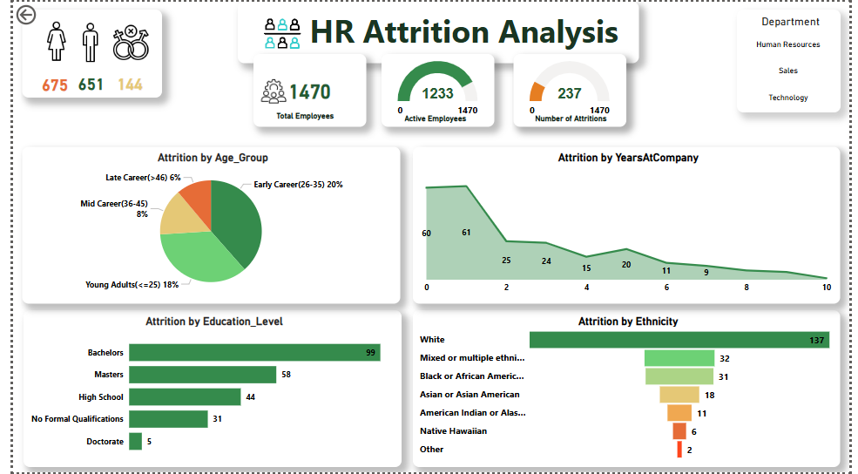

Slide 16
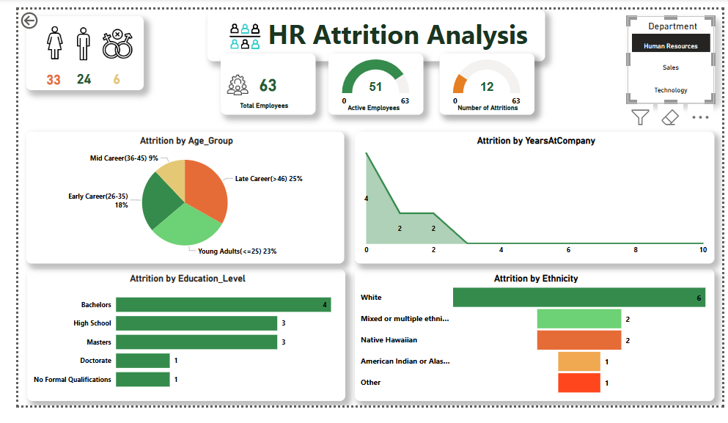
Human Resources Dept.
Attritions make about 19% of department’s total employees (12 out of 63 employees).

Slide 17
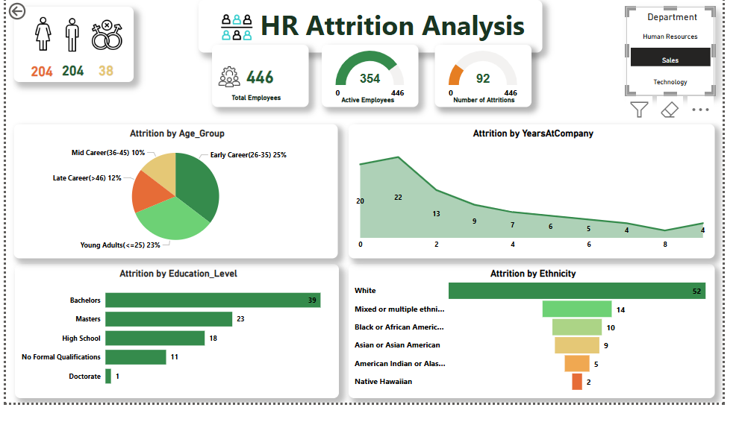
Sales Dept.
Attritions make about 20.6% of department’s total employees (92 out of 446 employees).

Slide 18
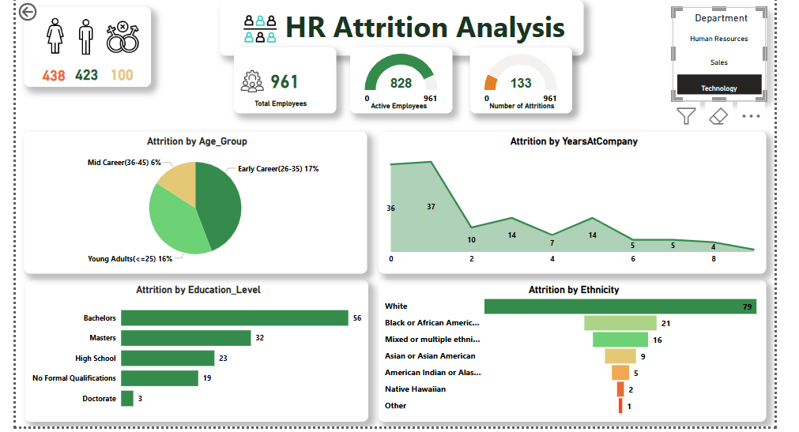
Technology Dept.
Attritions make about 13.8% of department’s total employees (133 out of 961 employees).

Slide 19
Attrition by state

Slide 20
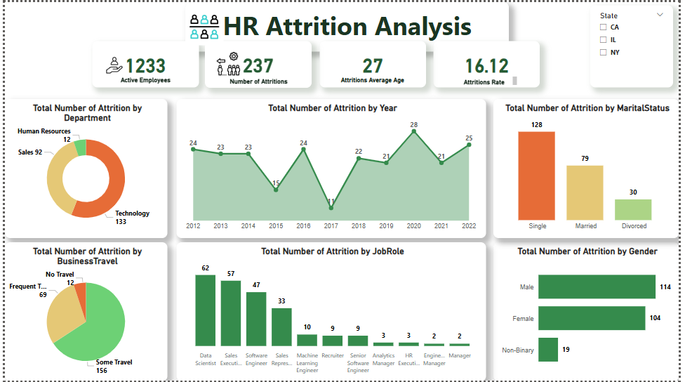

Slide 21
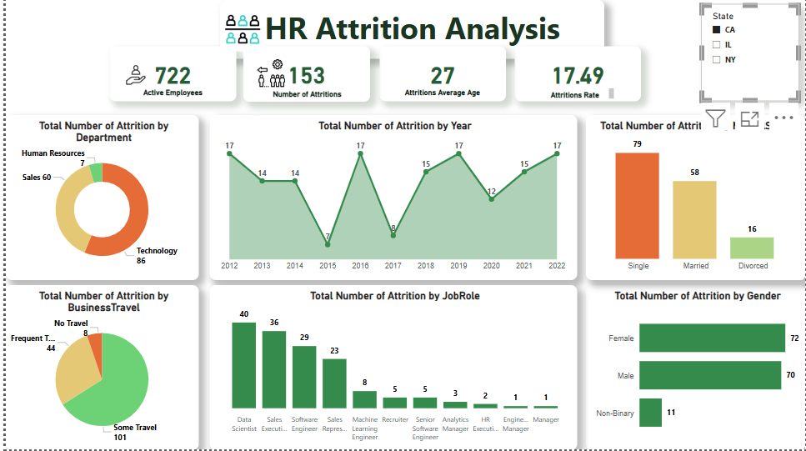
California

Slide 22
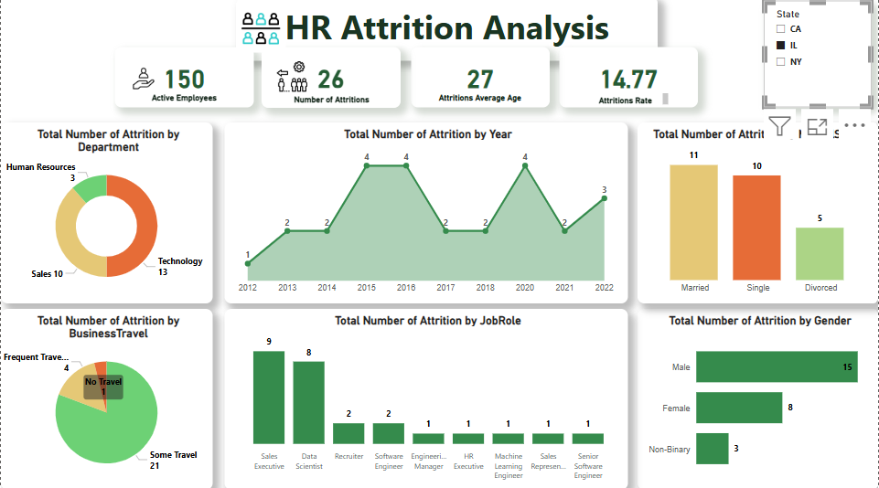
Illinois

Slide 23
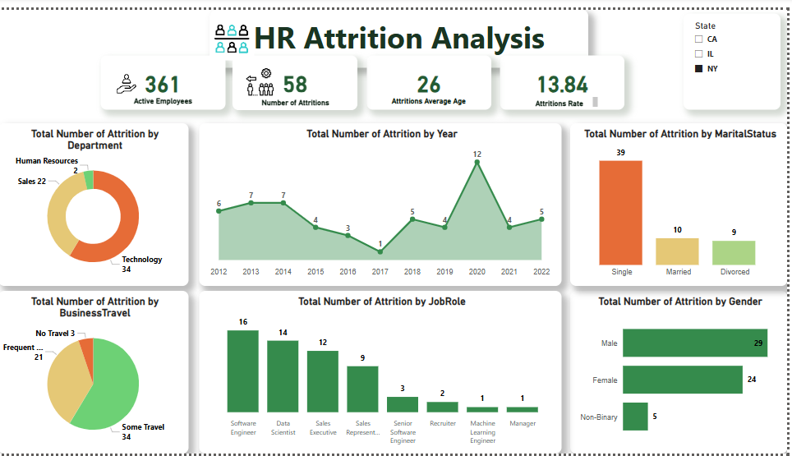
New York

Slide 24
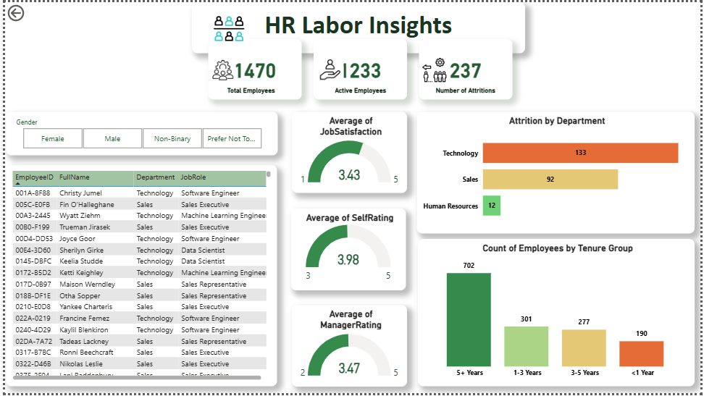
Summary
The 16.12% attrition rate highlights retention challenges
Especially among young professionals and early-career employees, who make up 90.3% of departures (214 employees).
Employees with bachelor’s degrees experience the highest attrition (99), followed by those with master’s degrees (58).
The Technology department faces the most turnover (133 employees), and single employees account for 54% of attrition (128 departures).

Slide 25
Recommendations
competitive benefits
Improve career growth opportunities
Increase compensation for low-paying roles
Address business travel impact
Focus on early-career engagement
Enhance work culture
Offer long-term career planning to improve workforce stability
HR PLAN
career growth opportunities
mentorship programs

Slide 26
Thank You

